Slide 1
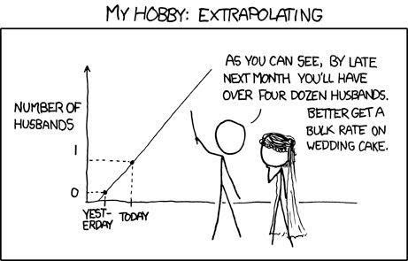
Assessing normality; Wilcoxon Tests
Geog4300/6300
Jerry Shannon

Slide 2
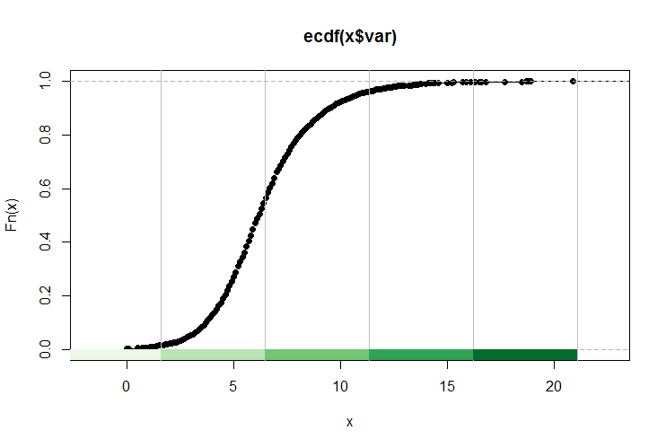
QQ plot: comparing % against actual value

Slide 3
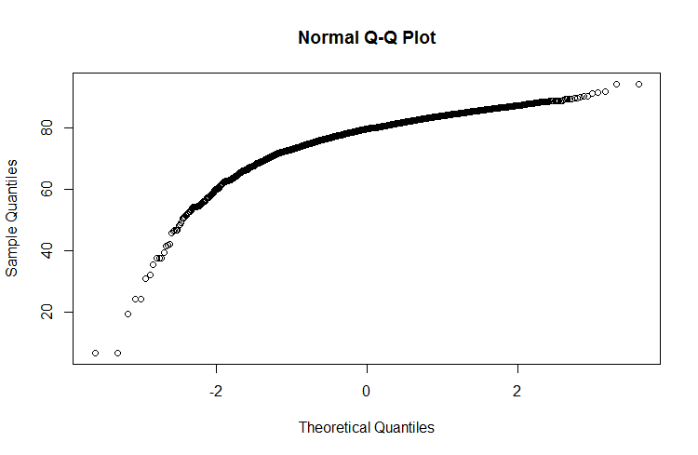
Testing normality with QQ plots
Comparing actual data with a normal distribution
% rank of actual data
comparison with hypothetical
normal distribution

Slide 4
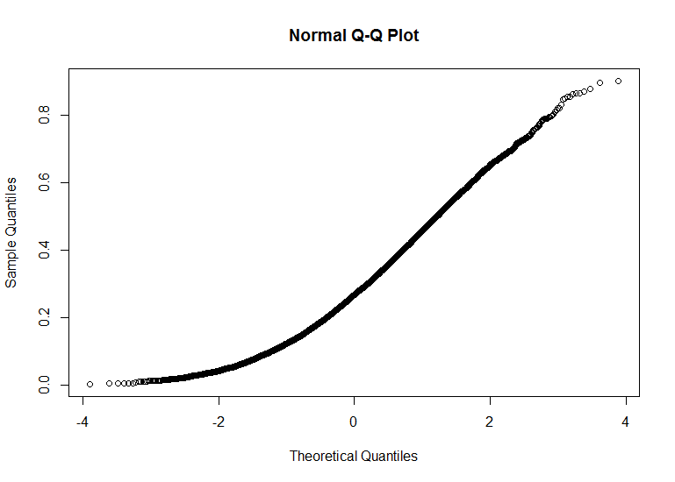
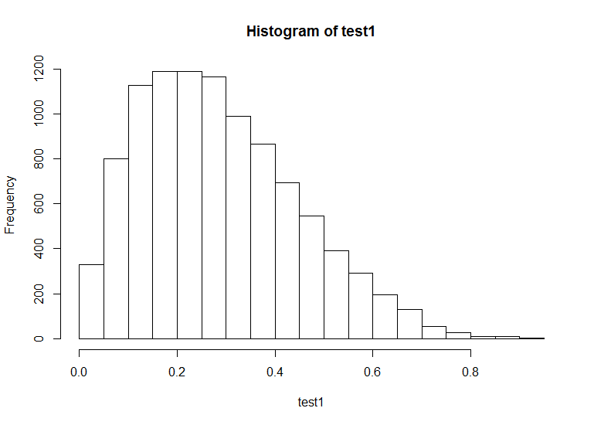

Slide 5
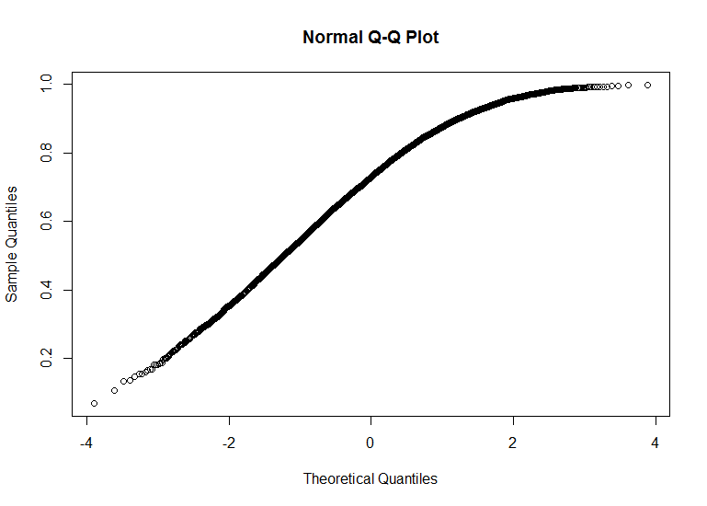
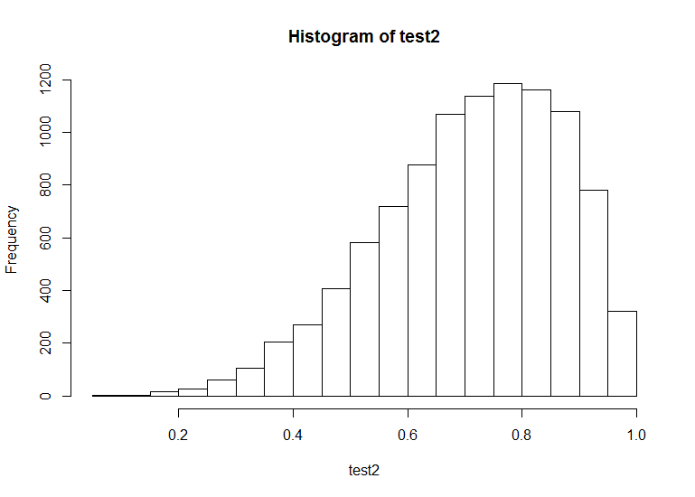

Slide 6
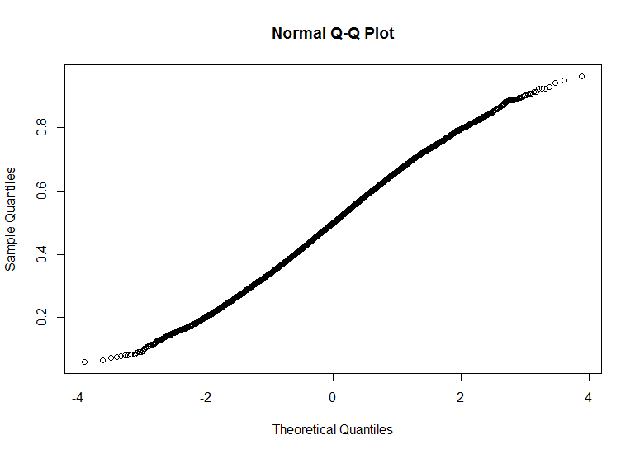
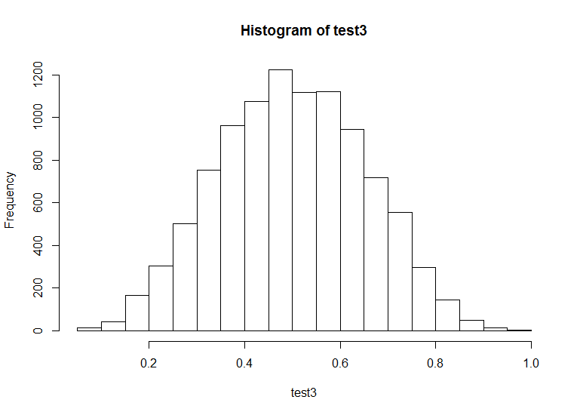

Slide 7
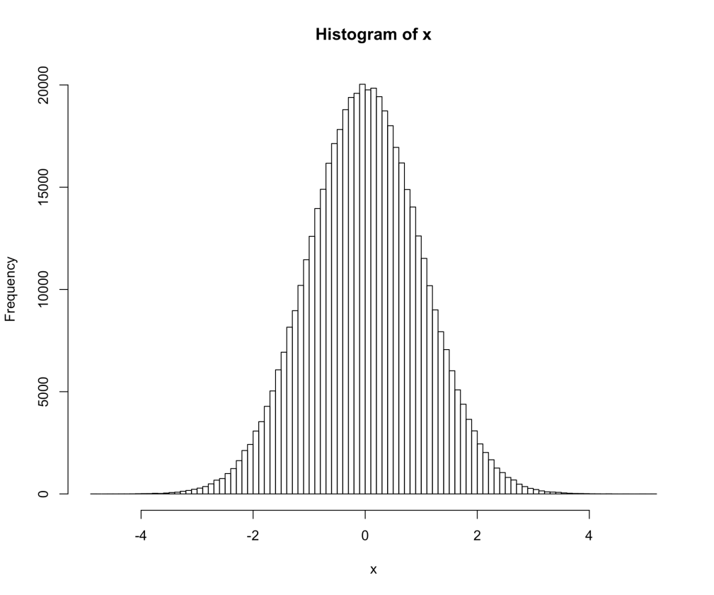
The Shaprio-Welk normality test also compares the actual distribution to a normal distribution, but takes multiple measures.
Some claim this test has more power when compared to other tests, especially with small samples.

Slide 8
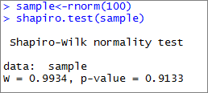
Normality tests in R

Slide 9
What if your samples aren’t normal?
Number of named Atlantic tropical storms, years
Random sample of hurricanes in El Nino and La Nina years—11 each
Why might this distribution NOT be normal?
You need a non-parametric test with data that’s not normal.
El Nino | La Nina
0 | 4
5 | 4
1 | 12
3 | 2
4 | 17
1 | 7
2 | 6
2 | 10
0 | 4
2 | 8
4 | 6

Slide 10

What if your samples aren’t normal?
Wilcoxon tests are one common alternative.
Two tests:
Rank sum: alternative to two sample t-test
Matched-Pairs Signed-ranks: alternative to matched pairs test
Frank Wilcoxon
Speed demon and statistician

Slide 11
Wilcoxon Rank Sum test
Number of named Atlantic tropical storms, years
Question: Is the number of Atlantic storms significantly different in El Nino years compared to La Nina years?
El Nino | La Nina
0 (1.5) | 4 (12)
5 (15) | 4 (12)
1 (3.5) | 12 (21)
3 (9) | 2 (6.5)
4 (12) | 17 (22)
1 (3.5) | 7 (18)
2 (6.5) | 6 (16.5)
2 (6.5) | 10 (20)
0 (1.5) | 4 (12)
2 (6.5) | 8 (19)
4 (12) | 6 (16.5)

Slide 12
Wilcoxon Rank Sum test
Number of named Atlantic tropical storms, years
Convert your data to ordinal ranks.
When tied, average the rank.
Here—there are two 0s, so average 1 and 2.
Two 1s, average 3 and 4…
El Nino | La Nina
0 (1.5) | 4 (12)
5 (15) | 4 (12)
1 (3.5) | 12 (21)
3 (9) | 2 (6.5)
4 (12) | 17 (22)
1 (3.5) | 7 (18)
2 (6.5) | 6 (16.5)
2 (6.5) | 10 (20)
0 (1.5) | 4 (12)
2 (6.5) | 8 (19)
4 (12) | 6 (16.5)

Slide 13
Wilcoxon Rank Sum test
Number of named Atlantic tropical storms, years
El Nino | La Nina
0 (1.5) | 4 (12)
5 (15) | 4 (12)
1 (3.5) | 12 (21)
3 (9) | 2 (6.5)
4 (12) | 17 (22)
1 (3.5) | 7 (18)
2 (6.5) | 6 (16.5)
2 (6.5) | 10 (20)
0 (1.5) | 4 (12)
2 (6.5) | 8 (19)
4 (12) | 6 (16.5)
Then sum the ranks in each column.
If the two columns are equal, the ranks should also be equal.
W₁ = 77.5 W₂ = 175.5

Slide 14
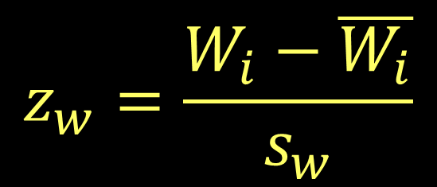
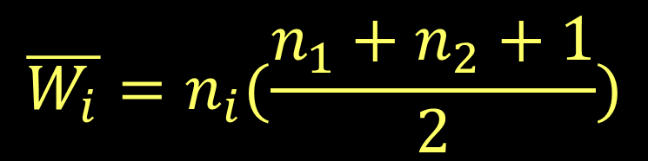
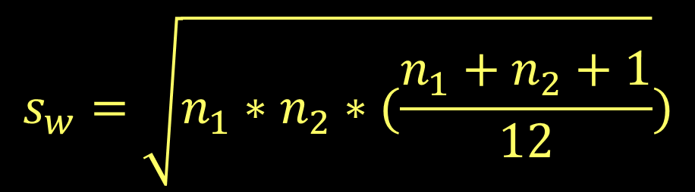
Wilcoxon Rank Sum test
Compare the observed rank sum to that we’d expect if the two groups were equal
W statistic for sample i
This statistic is a normal distribution

Slide 15
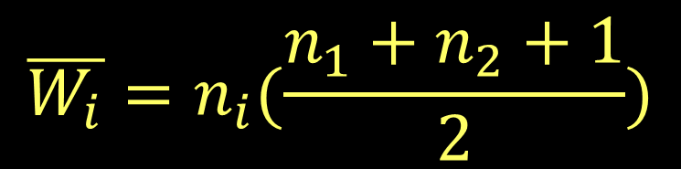
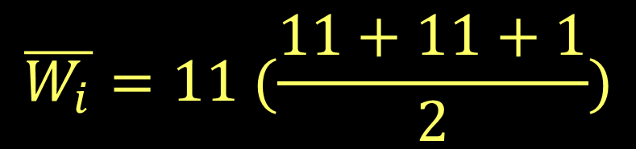

Wilcoxon Rank Sum test
Number of named Atlantic tropical storms, years
El Nino | La Nina
0 (1.5) | 4 (12)
5 (15) | 4 (12)
1 (3.5) | 12 (21)
3 (9) | 2 (6.5)
4 (12) | 17 (22)
1 (3.5) | 7 (18)
2 (6.5) | 6 (16.5)
2 (6.5) | 10 (20)
0 (1.5) | 4 (12)
2 (6.5) | 8 (19)
4 (12) | 6 (16.5)
W₁ = 77.5 W₂ = 175.5

Slide 16
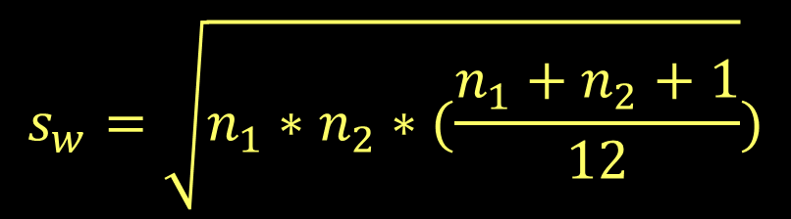
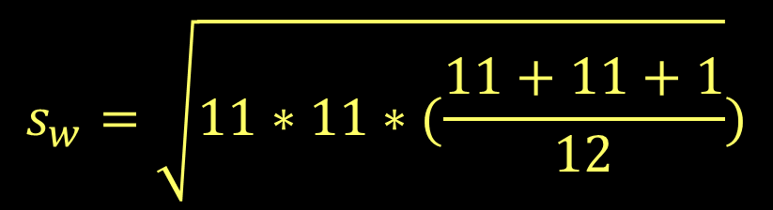

Wilcoxon Rank Sum test
Number of named Atlantic tropical storms, years
El Nino | La Nina
0 (1.5) | 4 (12)
5 (15) | 4 (12)
1 (3.5) | 12 (21)
3 (9) | 2 (6.5)
4 (12) | 17 (22)
1 (3.5) | 7 (18)
2 (6.5) | 6 (16.5)
2 (6.5) | 10 (20)
0 (1.5) | 4 (12)
2 (6.5) | 8 (19)
4 (12) | 6 (16.5)
W₁ = 77.5 W₂ = 175.5

Slide 17
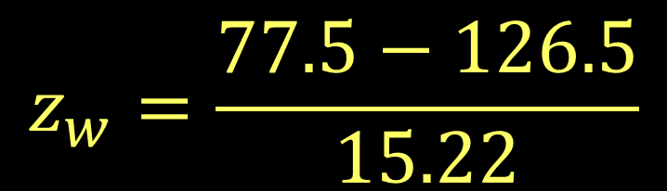

Wilcoxon Rank Sum test
Number of named Atlantic tropical storms, years
El Nino | La Nina
0 (1.5) | 4 (12)
5 (15) | 4 (12)
1 (3.5) | 12 (21)
3 (9) | 2 (6.5)
4 (12) | 17 (22)
1 (3.5) | 7 (18)
2 (6.5) | 6 (16.5)
2 (6.5) | 10 (20)
0 (1.5) | 4 (12)
2 (6.5) | 8 (19)
4 (12) | 6 (16.5)
Shows a significant difference between years
W₁ = 77.5 W₂ = 175.5

Slide 18
Wilcoxon Matched Pairs Signed-Ranks test
Non-parametric version of a matched pairs test
Goal is to compare changes in rank between matched samples
 | 2000 | 2010
A | 3 | 6
B | 11 | 12
C | 9 | 8
D | 14 | 18
E | 17 | 15
F | 7 | 13
G | 21 | 25
H | 13 | 9
I | 19 | 24
J | 5 | 10
Question: Did the rank of this region’s cities change significantly?
Regional cities’ national rank for population growth in previous 10 years

Slide 19
Wilcoxon Matched Pairs Signed-Ranks test
First find the absolute difference in ranks
Then assign ranks—averaging any ties.
 | 2000 | 2010 | Diff
A | 3 | 6 | 3 (4)
B | 11 | 12 | 1 (1.5)
C | 9 | 8 | 1 (1.5)
D | 14 | 18 | 4 (6)
E | 17 | 15 | 2 (3)
F | 7 | 13 | 6 (10)
G | 21 | 25 | 4 (6)
H | 13 | 9 | 4 (6)
I | 19 | 24 | 5 (8.5)
J | 5 | 10 | 5 (8.5)

Slide 20
Wilcoxon Matched Pairs Signed-Ranks test
Sum all positive ranks
(where 2000 > 2010)
And sum all negative ranks
 | 2000 | 2010 | Diff
A | 3 | 6 | 3 (4)
B | 11 | 12 | 1 (1.5)
C | 9 | 8 | 1 (1.5)
D | 14 | 18 | 4 (6)
E | 17 | 15 | 2 (3)
F | 7 | 13 | 6 (10)
G | 21 | 25 | 4 (6)
H | 13 | 9 | 4 (6)
I | 19 | 24 | 5 (8.5)
J | 5 | 10 | 5 (8.5)
T_{p} is the sum of positive ranks (C, E, H): 10.5
T_{n} is the sum of negative ranks (A, B, D, F, G, I, J): 44.5

Slide 21
Wilcoxon Matched Pairs Signed-Ranks test
For two tailed tests, use the smaller T (T_{p} here)
For one tailed tests, use the T that has less “members” (also T_{p} in this case—only 3 cities)
 | 2000 | 2010 | Diff
A | 3 | 6 | 3 (4)
B | 11 | 12 | 1 (1.5)
C | 9 | 8 | 1 (1.5)
D | 14 | 18 | 4 (6)
E | 17 | 15 | 2 (3)
F | 7 | 13 | 6 (10)
G | 21 | 25 | 4 (6)
H | 13 | 9 | 4 (6)
I | 19 | 24 | 5 (8.5)
J | 5 | 10 | 5 (8.5)
T_{p} is the sum of positive ranks (C, E, H): 10.5
T_{n} is the sum of negative ranks (A, B, D, F, G, I, J): 44.5

Slide 22
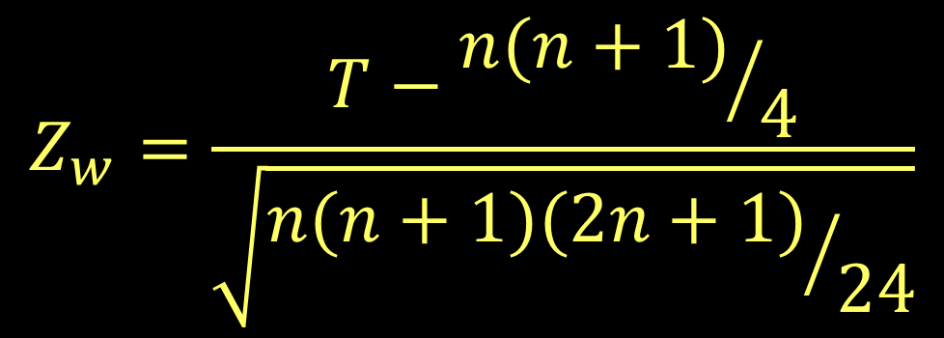
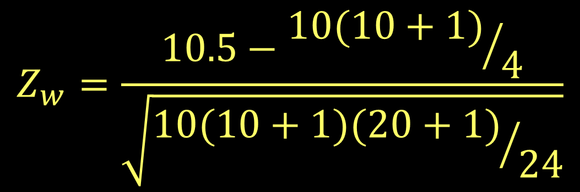


Wilcoxon Matched Pairs Signed-Ranks test

Slide 23

Wilcoxon in R

Slide 24
Project check in
Question: What changes do we see in election districts and gerrymandering between 1992 and 2016?
Data: Vote in U.S. House elections, census data

Slide 25
Format:
Descriptive stats for race, poverty, and district compactness, and election results in both years (tables and maps).
Correlation between these variables
Compute efficiency gap in both years

Slide 26
Questions for you:
Break up by states or years?
Worth doing multiple years?
Compactness and election results
Criteria for eligible state?

